Slide 1

Natural Language Processing
TTP Analysis using Retrieval Augmentation Generation (RAG) with Large Language Models
Reza Fayyazi
Project Proposal
Fall 2023

Slide 2
Motivation & Research Questions
Motivation
Incident threat analysis is challenging due to the volume and variety of change in vulnerabilities
MITRE ATT&CK [1] provides insights about the behaviors and techniques utilized by adversaries
Tactics, Techniques, and Procedures (TTPs) are to describe how and why attackers exploit vulnerabilities
TTP descriptions can be challenging to interpret due to their inherent ambiguity
Cyberattacks on Industrial Control Systems (ICS) can lead to service disruptions, safety hazards, and economic and environmental impacts.
Ambiguous ICS Descriptions lead to confusion in cybersecurity operations or even business, policy, and legal decisions.
Research Question
How well LLMs can interpret TTPs for Industrial Control Systems?
Can LLMs provide factually grounded answers with Retrieval Augmentation (RAG) [2] to build trust for cyber-operations?
[1] https://attack.mitre.org/
[2] Borgeaud, S., Mensch, A., Hoffmann, J., Cai, T., Rutherford, E., Millican, K., ... & Sifre, L. (2022, June). Improving language models by retrieving from trillions of tokens. In International conference on machine learning (pp. 2206-2240). PMLR.
1

Slide 3
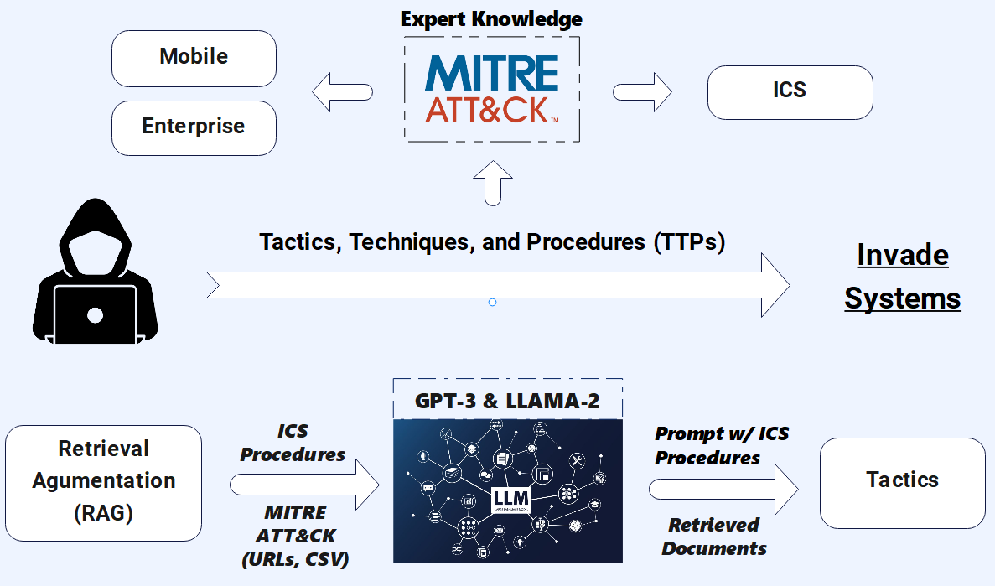
Methodology
Dataset
ICS Procedures
MITRE ATT&CK [1] Descriptions
Task
Multi-Label (12 tactics)
Metrics
Accuracy
F1 Score
[1] https://attack.mitre.org/
[2] Borgeaud, S., Mensch, A., Hoffmann, J., Cai, T., Rutherford, E., Millican, K., ... & Sifre, L. (2022, June). Improving language models by retrieving from trillions of tokens. In International conference on machine learning (pp. 2206-2240). PMLR.
2

Slide 4
Thank you!
Happy to answer any questions.
3

